Slide 1
Introduction To Automation Testing
- G Sunil Kumar

Slide 2
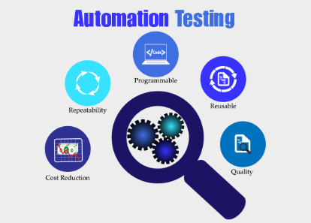
TABLE OF CONTENTS
What is Automation Testing?
Why Automated Testing?
Which Test Cases to Automate?
Automated Testing Process
Test tool selection
Define the scope of Automation
Planning, Design and
Development
8. Test Execution
Framework for Automation
Automation Tool Best Practices
11. Benefits of Automation Testing
12. Different types of software testing that can be automated
13. How to Choose an Automation Tool?
14. Automation Testing Tools

Slide 3
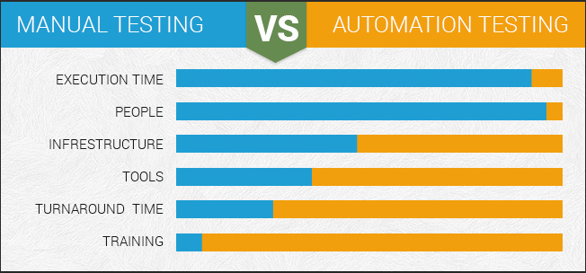
What is Automation Testing?
Manual Testing is performed by a human sitting in front of a computer carefully executing the test steps.
Automation Testing means using an automation tool to execute your test case suite.
The automation software can also enter test data into the System Under Test, compare expected and actual results and generate detailed test reports. Test Automation demands considerable investments of money and resources.
Successive development cycles will require execution of same test suite repeatedly. Using a test automation tool, it's possible to record this test suite and re-play it as required. Once the test suite is
automated, no human intervention
is required. This improved ROI of
Test Automation. The goal of
Automation is to reduce
the number of test cases to be run
manually and not to eliminate
Manual Testing altogether.

Slide 4
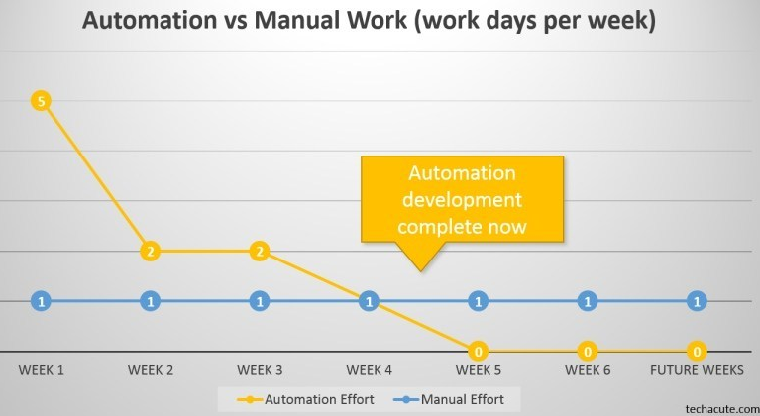
Why Automated Testing?
Automated software testing is important due to the following reasons:
Manual Testing of all workflows, all fields, all negative scenarios is time and money consuming
It is difficult to test for multilingual sites manually
Automation does not require Human intervention. You can run automated test unattended (overnight)
Automation increases the
speed of test execution
Automation helps increase
Test Coverage
Manual Testing can become
boring and hence error-prone.

Slide 5
Which Test Cases to Automate?
Test cases to be automated can be selected using the following criterion to increase the automation ROI
High Risk - Business Critical test cases
Test cases that are repeatedly executed
Test Cases that are very tedious or difficult to perform manually
Test Cases which are time-consuming
The following category of test cases are not suitable for automation:
Test Cases that are newly designed and not executed manually at least once
Test Cases for which the requirements are frequently changing
Test cases for which the data from data base is rarely available.
Test cases which are executed on an ad-hoc basis.

Slide 6
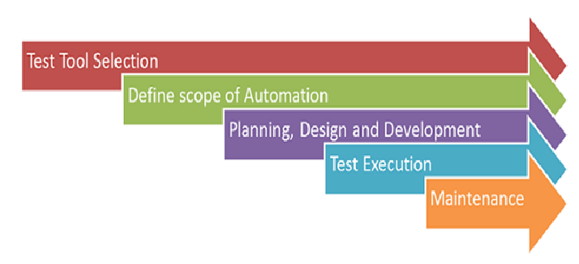
1. Automated Testing Process

Slide 7
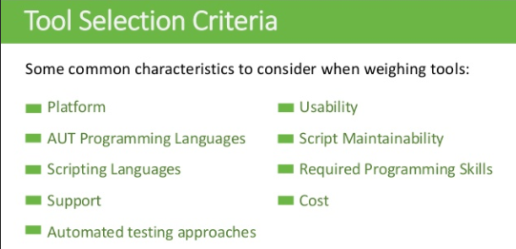
2. Automation Test tool selection
Test Tool selection largely depends on the technology the Application Under Test is built on. For instance, QTP does not support Informatica. So QTP cannot be used for testing Informatica applications.
It's a good idea to conduct a Proof of Concept of Tool on AUT.

Slide 8
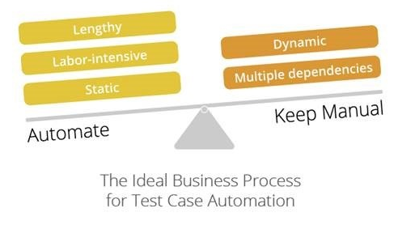
3. Define the scope of Automation
The scope of automation is the area of your Application Under Test which will
automated. Following points help determine scope:
The features that are important for the business
Scenarios which have a large amount of data
Common functionalities across applications
Technical feasibility
The extent to which business
components are reused
The complexity of test cases
Ability to use the same test cases
for cross-browser testing

Slide 9
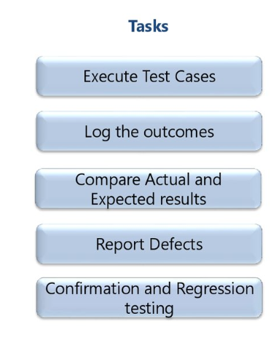
4. Test Execution
Automation Scripts are executed during this phase.
The scripts need input test data before they are set to run.
Once executed they provide detailed test reports.
Execution can be performed using the
automation tool directly
or through the Test Management tool which
will invoke the automation tool.
Example: Quality center is the Test
Management tool which in turn it will invoke
QTP for execution of automation scripts.
Scripts can be executed in a single machine
or a group of machines.
5. The execution can be done during the night,
to save time.

Slide 10
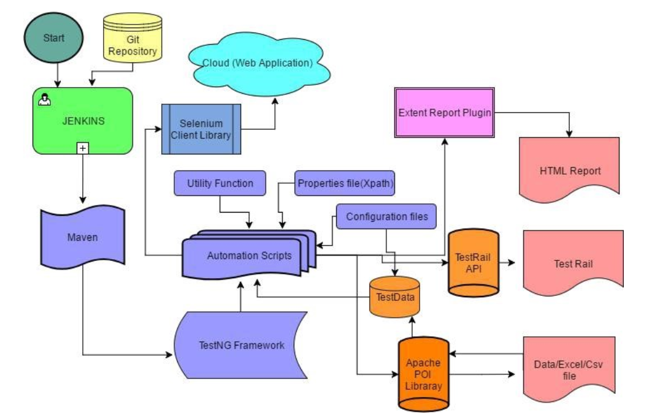
5. Maintenance
As new functionalities are added to the System Under Test with successive cycles, Automation Scripts need to be added, reviewed and maintained for each release cycle.
Maintenance becomes necessary to improve the effectiveness of Automation Scripts.

Slide 11
Framework for Automation
The framework provides the user with various benefits that help them to develop,
execute and report the automation test scripts efficiently.
Advantages of Automation Framework
1. Maintaining consistency of Testing
2. Improves test structuring
3. Minimum usage of code
4. Less Maintenance of code
5. Improve re-usability
6. Non Technical testers can be involved in code
7. The training period of using the tool can be reduced
8. Involves Data wherever appropriate

Slide 12
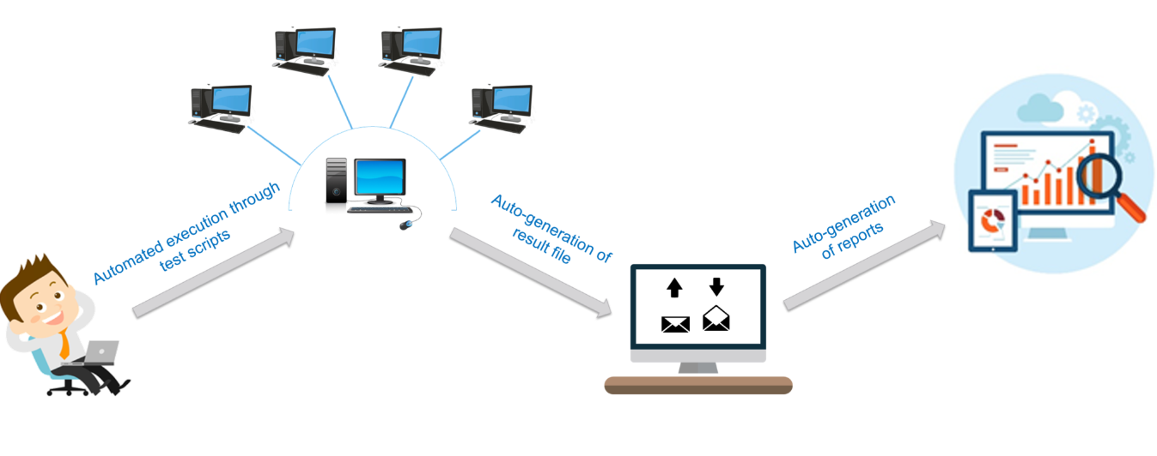
Types of Automation Framework
Data Driven Automation Framework
Keyword Driven Automation Framework
Modular Automation Framework
Hybrid Automation Framework
Behavioral Driven Development Framework

Slide 13
Automation Tool Best Practices
To get maximum ROI of automation, observe the following
The scope of Automation needs to be determined in detail before the start of the project. This sets expectations from Automation right.
Select the right automation tool: A tool must not be selected based on its popularity, but it's fit to the automation requirements.
Choose an appropriate framework
Scripting Standards- Standards have to be followed while writing the scripts for Automation. Some of them are-
Create uniform scripts, comments, and indentation of the code

Slide 14
Automation Tool Best Practices – Contd..
6. Adequate Exception handling - How error is handled on system failure or unexpected behavior of the application.
User-defined messages should be coded or standardized for Error Logging for testers to understand.
Percent of defects found
10. The time required for automation testing for each and every release cycle
11. Minimal Time is taken for release
12. Customer Satisfaction Index
13. Productivity improvement
The above guidelines if observed can greatly help in making your automation successful.

Slide 15
Benefits of Automation Testing
Following are benefits of automated testing:
70% faster than the manual testing
Wider test coverage of application features
Reliable in results
Ensure Consistency
Saves Time and Cost
Improves accuracy
Human Intervention is not required while execution
Increases Efficiency
Better speed in executing tests
Re-usable test scripts
Test Frequently and thoroughly
More cycle of execution can be achieved through automation
Early time to market

Slide 16
Types of testing that can be automated
Smoke Testing / Health Check
Unit Testing
Integration Testing
Functional Testing
Keyword Driven Testing
Regression Testing
Data Driven Testing
Black Box Testing

Slide 17
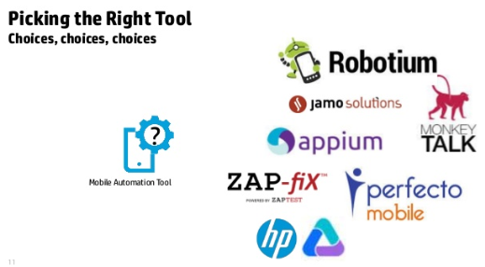
How to Choose an Automation Tool?
Following criterion will help you select the best tool for your requirement-
Environment Support
Ease of use
Object Identification
Mechanism
4. Scripting Language Used
Support for various types of
test - including functional,
test management, mobile
etc.
Support for multiple testing
frameworks

Slide 18
Choosing an Automation Tool – Contd..
7. Ease of debugging the automation software scripts
8. Ability to recognize objects in any environment
9. Extensive test reports and results
10. Lesser training cost of selected tools
Tool selection is one of biggest challenges to be tackled before going for automation.
First, Identify the requirements, explore various tools and its capabilities, set the expectation from the tool and go for a Proof Of Concept.

Slide 19
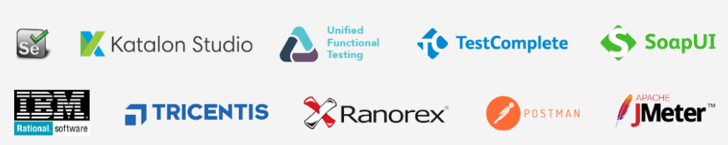
Automation Testing Tools
Here are 8 best tools available in the market.
Ranorex Studio
Ranorex Studio is an
all-in-one tool for
automating functional
UI tests,
regression tests, data-driven tests and much more.
Ranorex Studio includes an easy to use click-and-go interface to automate tests for
web, desktop, and mobile applications.
Features:
Functional UI and end-to-end testing on desktop, web, and mobile
Cross-browser testing , iOS and Android
SAP, ERP, Delphi and legacy applications.
Run tests locally or remotely, in parallel or distribute on a Selenium Grid
mabl
mabl delivers scriptless end-to-end test automation, integrated with your delivery pipeline,
so you can focus on improving your app.
Features:
Proprietary machine learning models automatically identify and surface application issues
Tests are automatically repaired when UI changes
Automated regression insights on every build

Slide 20
Automation Testing Tools – Contd ..
Testim
Testim uses artificial intelligence to speed-up the authoring, execution, and maintenance of automated tests. It uses dynamic locators that learn with every execution and adapts to code changes, minimizing maintenance time spent fixing flaky tests. The outcome is self-healing tests with results you can trust.
root cause analysis
cross browser testing
visual validations
integrate with your CI/CD; JIRA, Slack, Git, Trello
your choice of GUI + JS based custom code
Selenium
It is a software testing tool used for Function and Regression Testing. It is an open source testing tool that provides playback and recording facility for Regression Testing. The Selenium IDE only supports Mozilla Firefox web browser.
It provides the provision to export recorded script in other languages like Java, Ruby, RSpec, Python, C#, etc
It can be used with frameworks like JUnit and TestNG
It can execute multiple tests at a time

Slide 21
Automation Testing Tools – Contd ..
4. Identifies the element using id, name, X-path, etc.
5. Store tests as Java, C#, Ruby Script, HTML, and any other format
6. Supports multi browser testing and Parallel Testing
7. Highly portable tool – Works across various OS including Windows, Linux, Mac OS, Unix etc.
8. Less Hardware Usage compared to other tools

Slide 22
Automation Testing Tools – Contd ..
QTP (MicroFocus UFT)
QTP is widely used for functional and regression testing, it addresses every major software application and environment. To simplify test creation and maintenance, it uses the concept of keyword driven testing. It allows the tester to build test cases directly from the application.
It is easier to use for a non-technical person to adapt to and create working test cases
Scripting Language is VB script
It fix defects faster by thorough documentation at a single site
Parameterization is easy than WinRunner
It has better object identification mechanism
It can enhance existing QTP scripts without "Application Under Test" is available, by using the active screen
Various versions available are 8.2. 9.5 and 10.
Library files contains VBScript functions.
QTP supports .NET development sub routines that can be added to the test.

Slide 23
Automation Testing Tools – Contd ..
Rational Functional Tester
It is an Object-Oriented automated Functional Testing tool that is capable of performing automated functional, regression, data-driven testing and GUI testing.
The main features of this tool are
It supports a wide range of languages and applications like Java, HTML, NET, Windows, SAP, Visual Basic, etc.
It can record and replay the actions on demand
It integrates well with source control management tools such as Rational Clear Case and Rational Team Concert integration
It allows developers to create keyword associated script so that it can be re-used
Eclipse Java Developer Toolkit editor facilitates the team to code test scripts in Java with Eclipse
It supports custom controls through proxy SDK (Java/.Net)
It supports version control to enable parallel development of test scripts and concurrent usage by geographically distributed team

Slide 24
Automation Testing Tools – Contd ..
WATIR
It is an open source testing software for regression testing. It enables you to write tests that are easy to read and maintain.
Watir Classic supports only internet explorer on windows while Watir webdriver supports Chrome, Firefox, IE, Opera, etc.
It supports multiple browsers on different platforms
Rather than using proprietary vendor script, it uses a fully-featured modern scripting language Ruby
It supports your web app regardless of what it is developed in
SilkTest
Silk Test is designed for doing functional and regression testing. For e-business application, silk test is the leading functional testing product. It is a product of Segue Software takeover by Borland in 2006. It is an object-oriented language just like C++. It uses the concept of an object, classes, and inheritance. Its main feature includes
It consists of all the source script files
It converts the script commands into GUI commands. On the same machine, commands can be run on a remote or host machine
To identify the movement of the mouse along with keystrokes, Silktest can be executed. It can avail both playback and record method or descriptive programming methods to get the dialogs
It identifies all controls and windows of the application under test as objects and determines all of the attributes and properties of each window

Slide 25
Conclusion and References
  The right selection of automation tool, testing process, and team, are important players for automation to be successful.
  Manual and automation methods go hand-in-hand for successful testing.
REFERENCES
  Automation Testing fundamentals - https://www.guru99.com/automation-testing.html
  Automated Software Testing - https://www.tutorialspoint.com/software_testing_dictionary/automated_software_testing
  Ranorex Studio - https://www.ranorex.com/blog/studio-quick-start/
  Mabl- https://www.youtube.com/watch?v=xTi7BiIb_fg
  Testim - https://www.youtube.com/watch?v=bCvVgT5owv0
  Advantages of Selenium - https://dzone.com/articles/11-reasons-why-go-for-automation-testing-using-sel
  Qtp- https://www.guru99.com/uft-qtp-automation-testing.html
  Rational Functional Tester – Similar to Eclipse IDE - https://www.youtube.com/watch?v=venklcLj0RY
  Watir - https://www.youtube.com/watch?v=venklcLj0RY
  Silk Test - https://www.youtube.com/watch?v=rLQ7ufH04xs

Slide 26
THANK YOU

Slide 27


